Slide 1
Weather Prediction and Forecasting National Centre for Polar and Ocean Research (NCPOR GOA)
Faculty – Dr. Jabez J Christopher
Mentor – Dr. Sakthivel Swamy V
Harshit Agrawal (2018A8PS0484P)
EEE department, Pilani campus

Slide 2
INTRODUCTION
WEATHER PREDICTION AND FORECASTING
Weather forecasting is the application of science and technology to predict the conditions of the atmosphere at a given location and time. This includes temperature, precipitation, cloudiness, wind speed, humidity etc.
Prediction vs Forecasting
Forecasting is usage of time-series data to extrapolate the past observations into the future using Deep Learning models such as CNNs, RNNs, LSTMs.
Prediction is judgmental and takes into account changes taking place in the future
Four types of forecasting - climatology, analog, persistence and trends.
Methodology - Data Collection, Visualization, Cleaning and Deep Learning models application.

Slide 3
PROJECT DETAILS
We aim to predict and forecast the weather conditions in Antarctic region using the data and observations available for past 4 years ( 02-06-2016 :: 19-06-2019 )
There are various parameters such as temperature, relative humidity, precipitation, air pressure, wind speed and wind direction.
Data visualisation includes plotting various scatter plots for all the above parameters and analysing their variation over time i.e. scatter plots for time series data.
Plotting scatter plots of date with time (24 hrs) and colour coding the coordinates of plot using temperature values as colormap using seaborn and matplotlib.
Understanding the seasonality, noise, trend present in the data and removing it by moving averages and differencing methods.
Using data pre-processing techniques such as train-test split and preparation of data to be fed into the model.
Finally applying Deep Learning models such as CNNs, RNNs, LSTMs to our data to accurately forecast the parameter value.
Perform several evaluations using metrics (MAE, MSE, RMSE) on train and test sets and also performing K-fold cross validation to determine which train test is best and what is the overall performance of our model.
Making our project robust enough to determine itself which model out of CNN, RNN, LSTM work on the data fed.

Slide 4
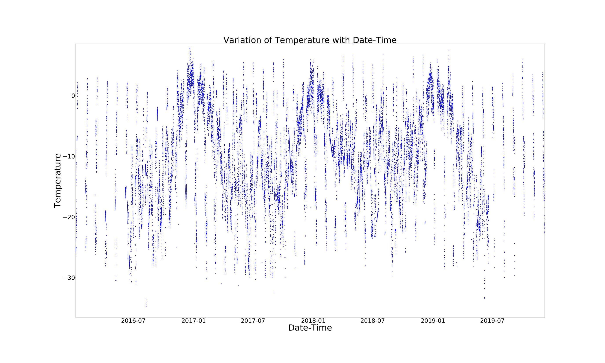
Scatter plot of temperature with datetime.

Slide 5
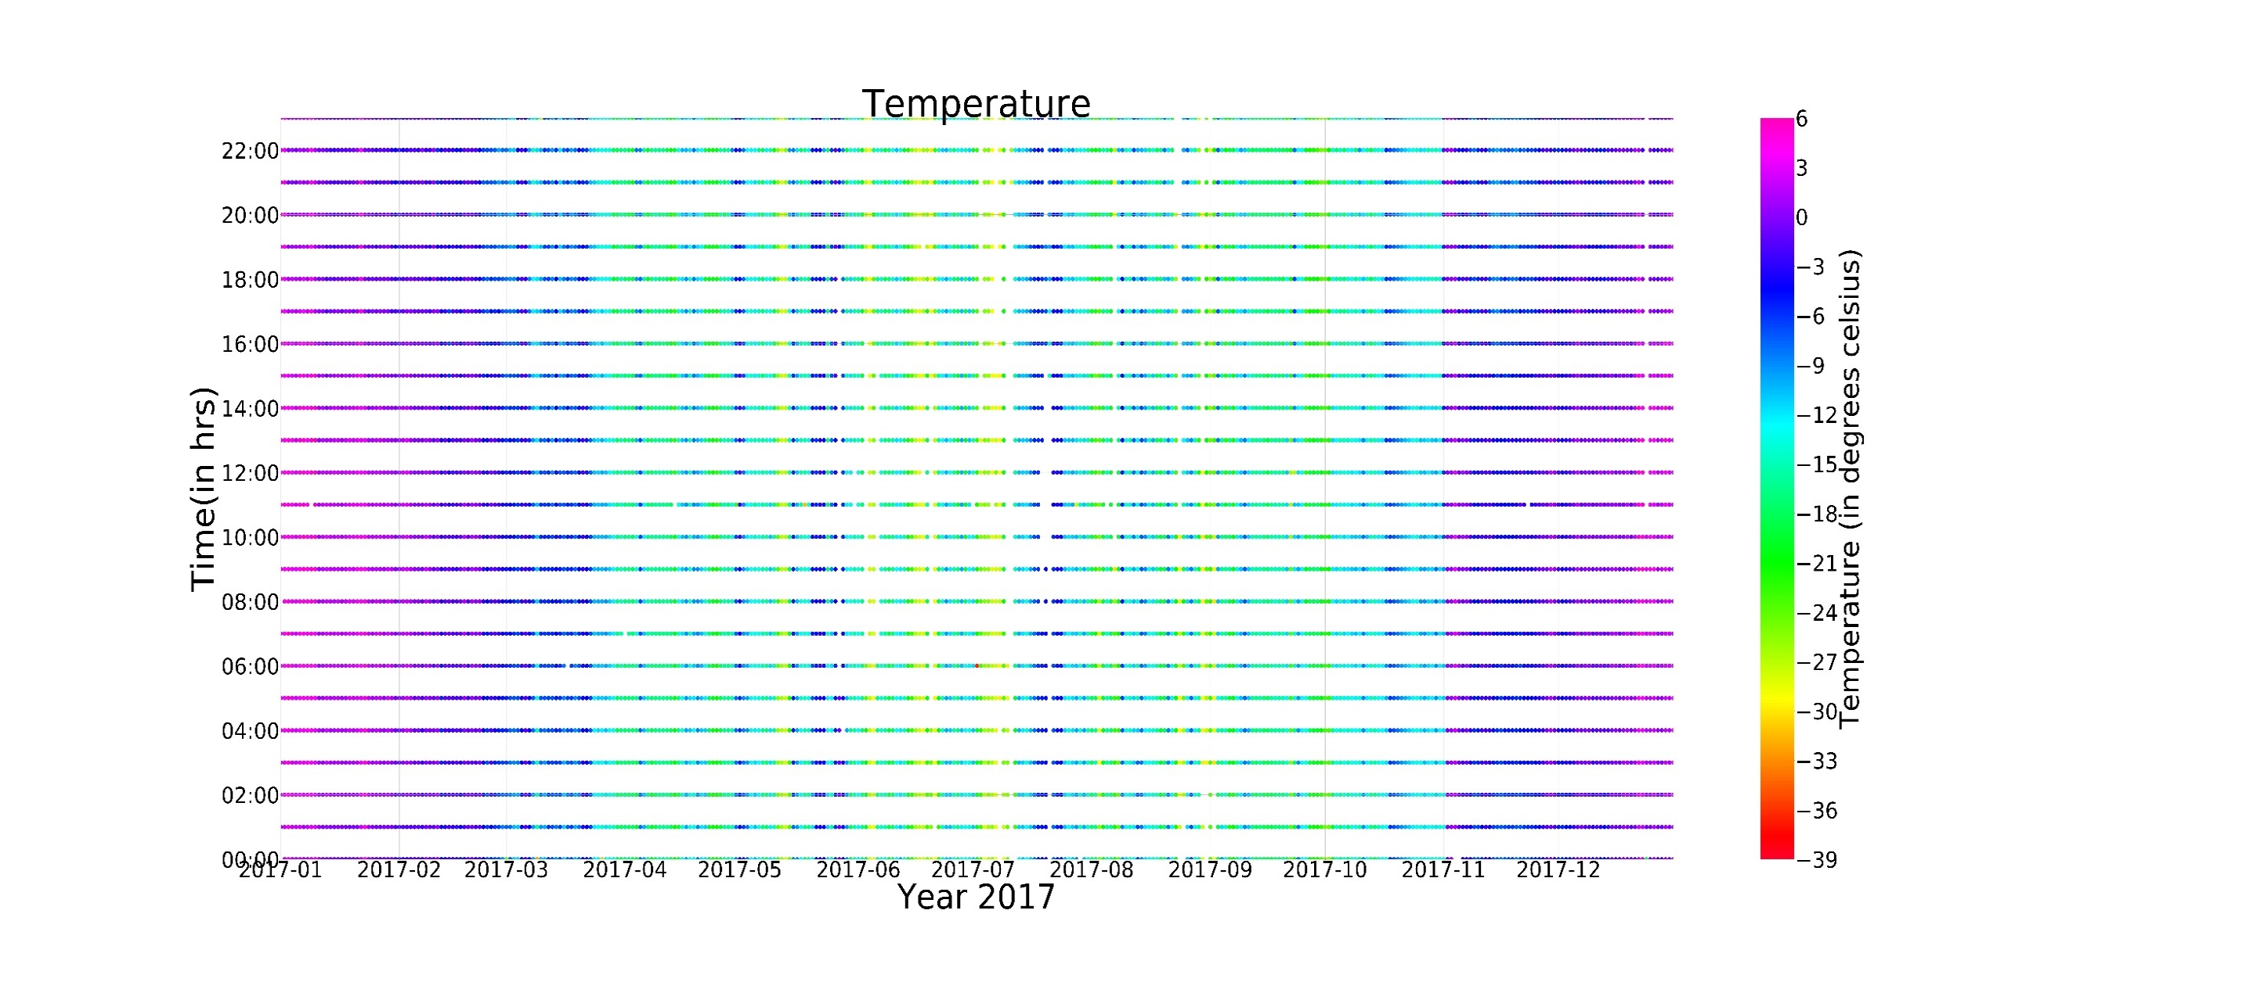
Scatter plot of temperature (Year 2017) using colormap

Slide 6
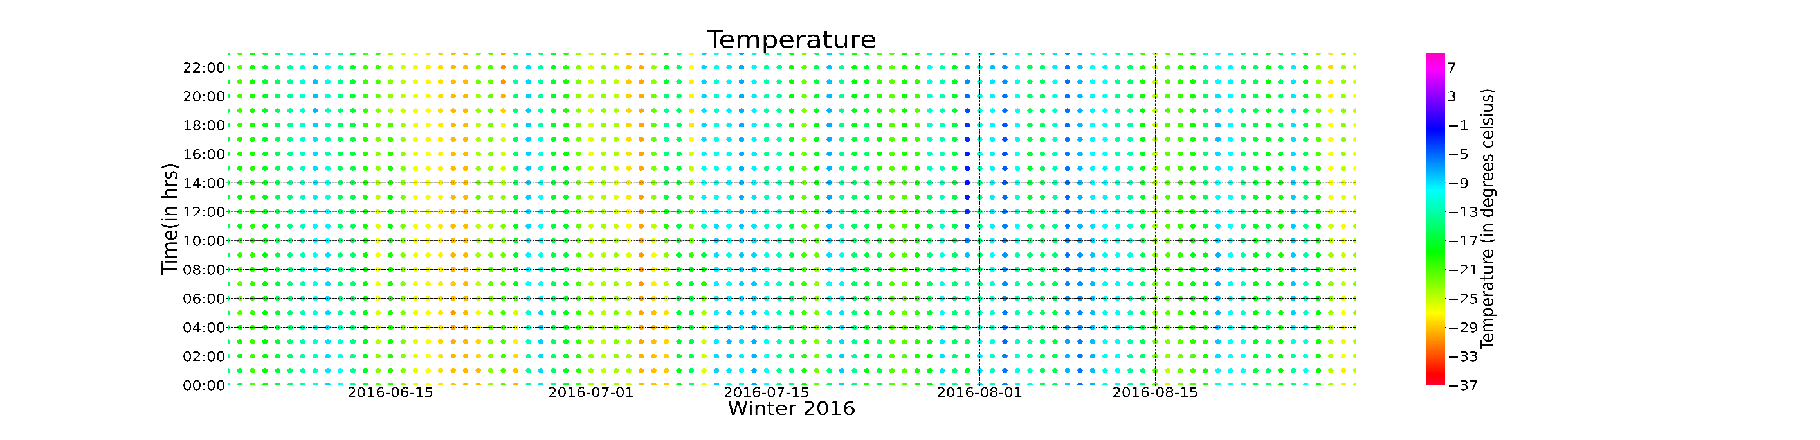
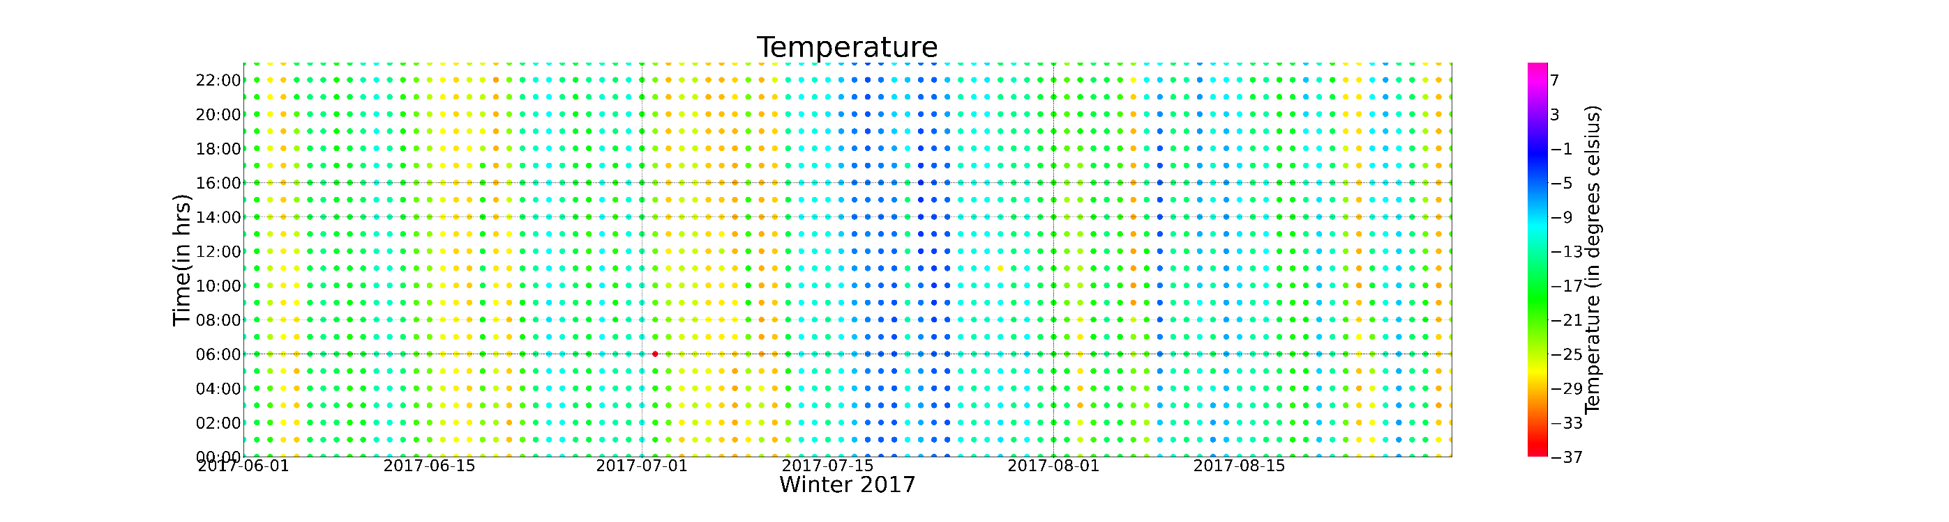
Scatter plots of temperature using colormap/colorbar (winter season)

Slide 7
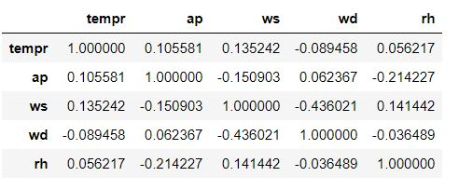
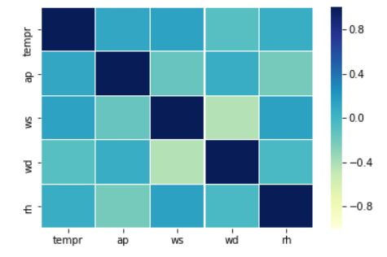
Correlation Matrix

Slide 8
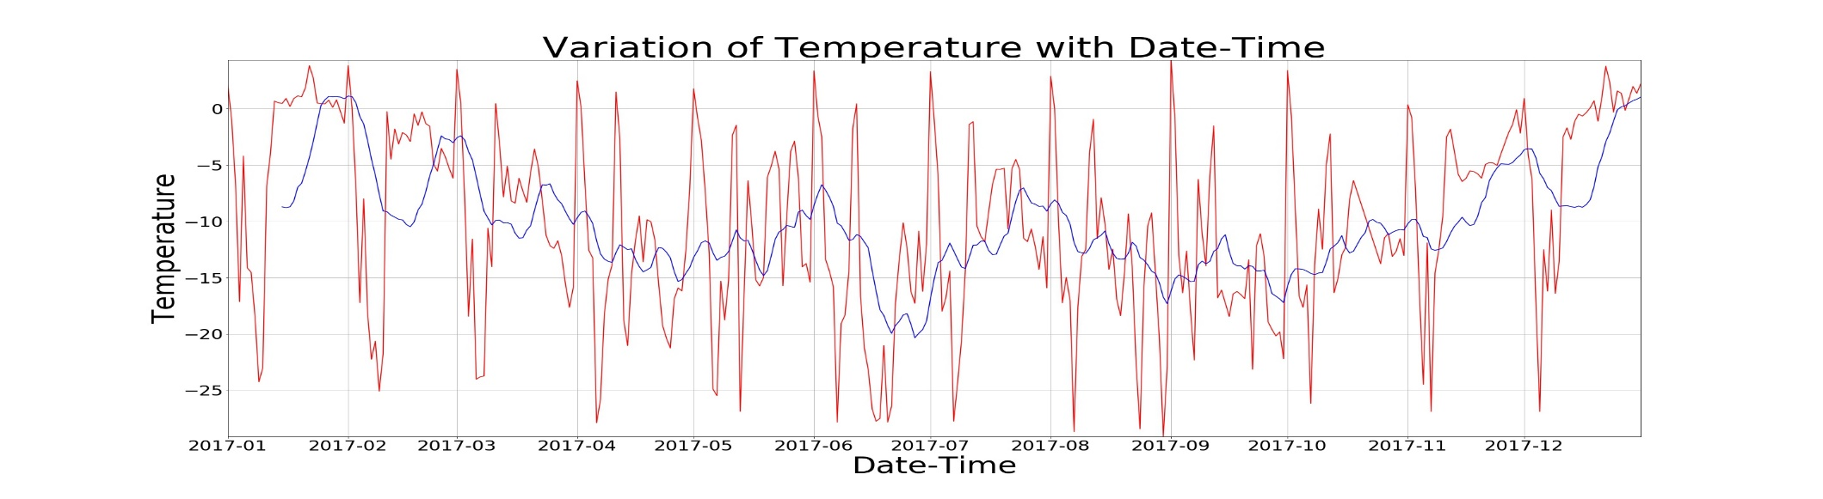
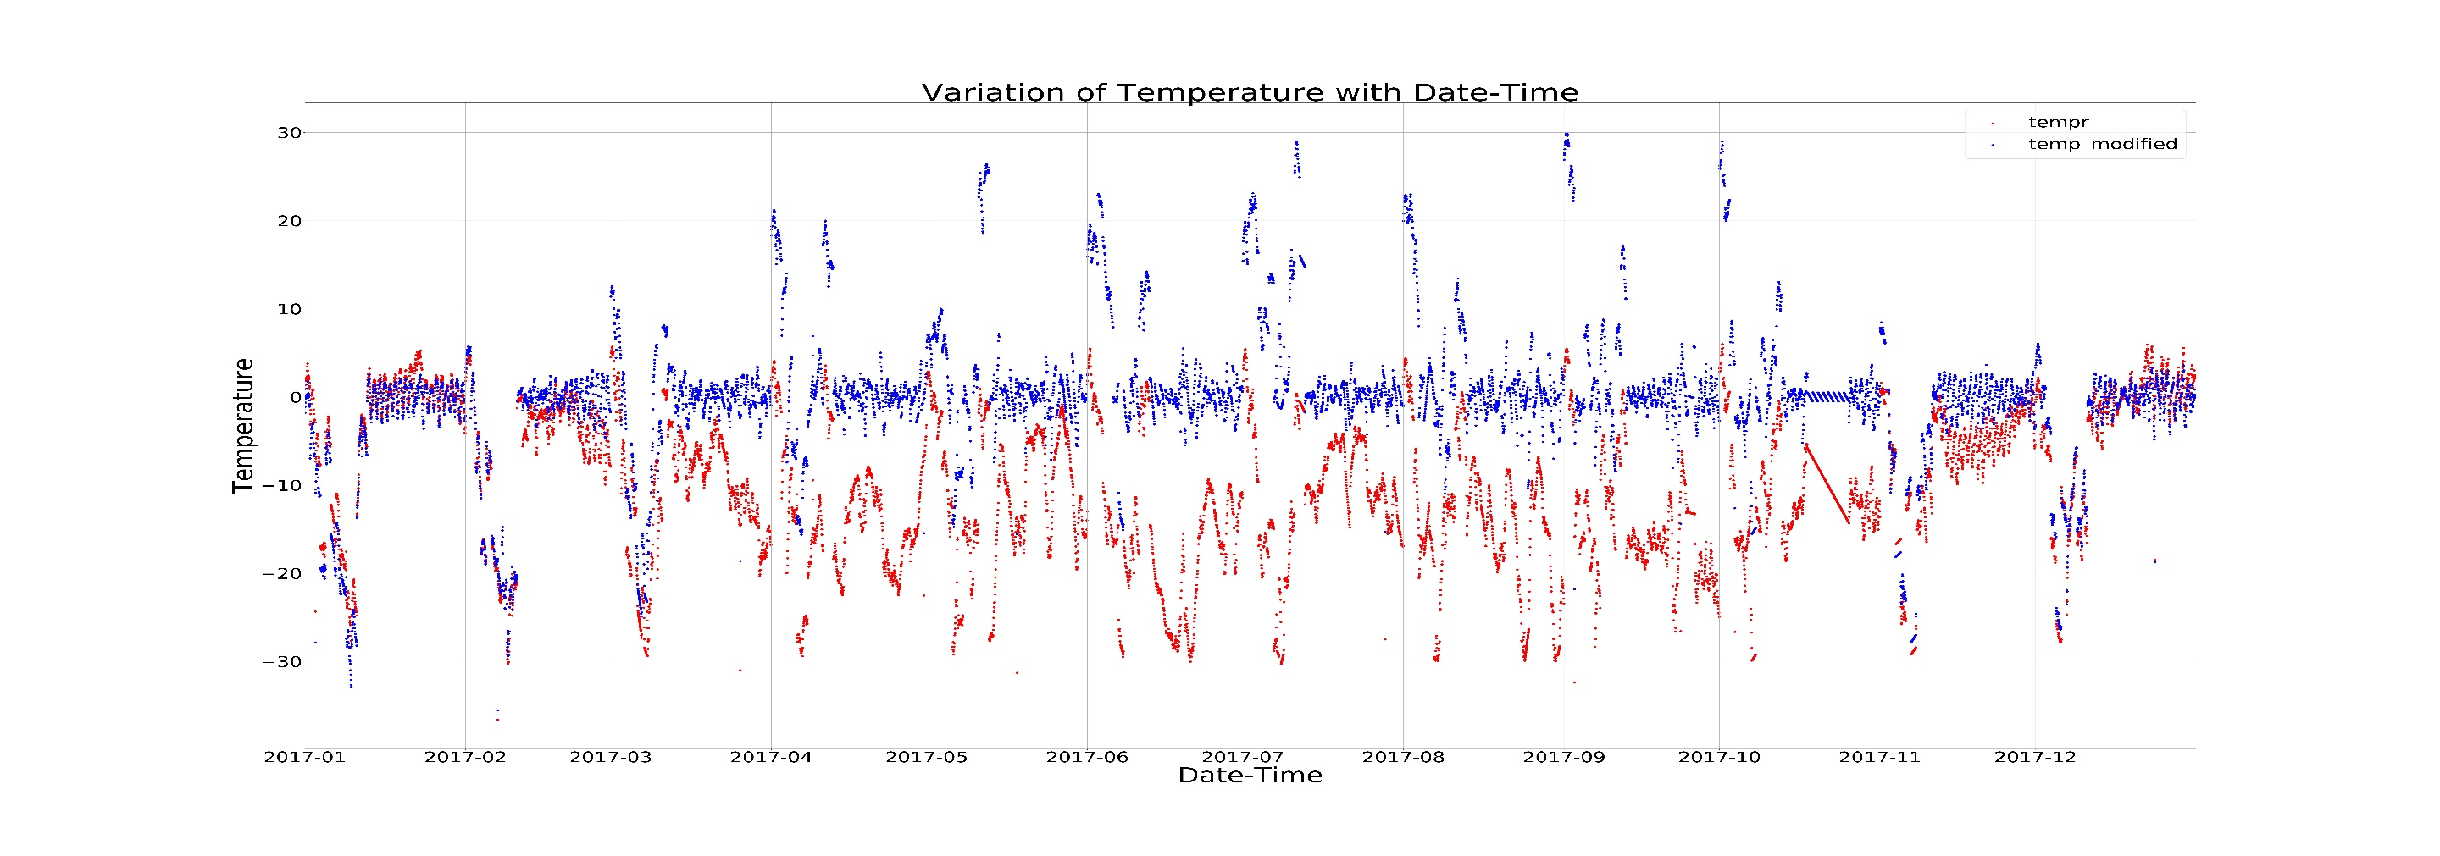
Moving Averages and Differencing
DDIFFER
Differencin

Slide 9
DATA PREPROCESSING
Calculated daily mean temperatures and used this dataset for further processing.
Used 80-20 train-test split as default for training and testing models.
Created the data to be fed by writing a create_dataset function. It split the array containing the temperature values into multiple samples based on the timesteps chosen. Temperature values equal to timesteps constitute one sample and the temperature value immediately after it is the label (which model learns ).
Used CNN, RNN, LSTM. Different timesteps were chosen for the 3 models.
Shapes: X_train – (samples, timesteps, features) y_train – (samples, ).
Normalization was not required as the temperature values were in a satisfactory range for the model to learn. Infact the model performed marginally better without normalization.

Slide 10
Deep Learning Application

Slide 11
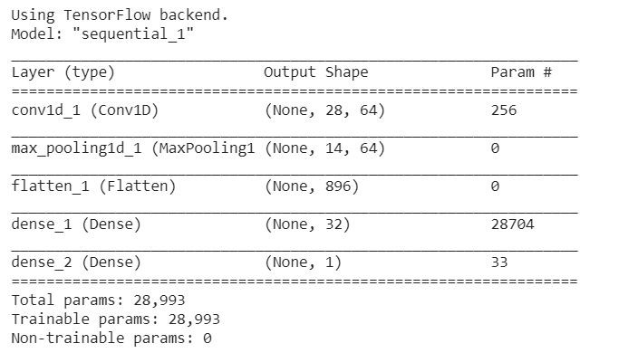
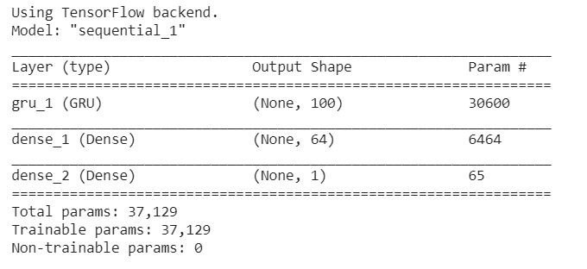
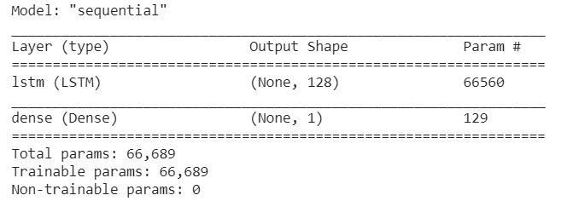
MODELS USED
Convolutional Neural Network (CNN) : A 1D CNN is very effective when we expect to derive interesting features from shorter (fixed-length) segments of the overall data set and where the location of the feature within the segment is not of high relevance.
Recurrent Neural Network (RNN) : Gated recurrent units are a gating mechanism in recurrent neural networks. The GRU is like a long short-term memory with a update gate but has fewer parameters than LSTM, as it lacks an output gate.
Long Short Term Memory (LSTM) : Long Short Term Memory networks – usually just called “LSTMs” – are a special kind of RNN, capable of learning long-term dependencies.
Used Adam optimizer to train all the 3 models.

Slide 12
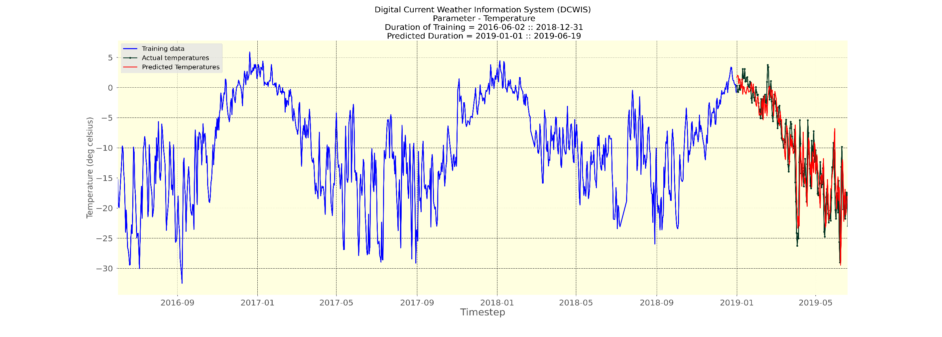
MODEL USED - CNN
MAE (Mean Absolute Error) | MSE (Mean Squared Error) | RMSE (Root Mean Squared Error)
2.58 | 12.12 | 3.48

Slide 13
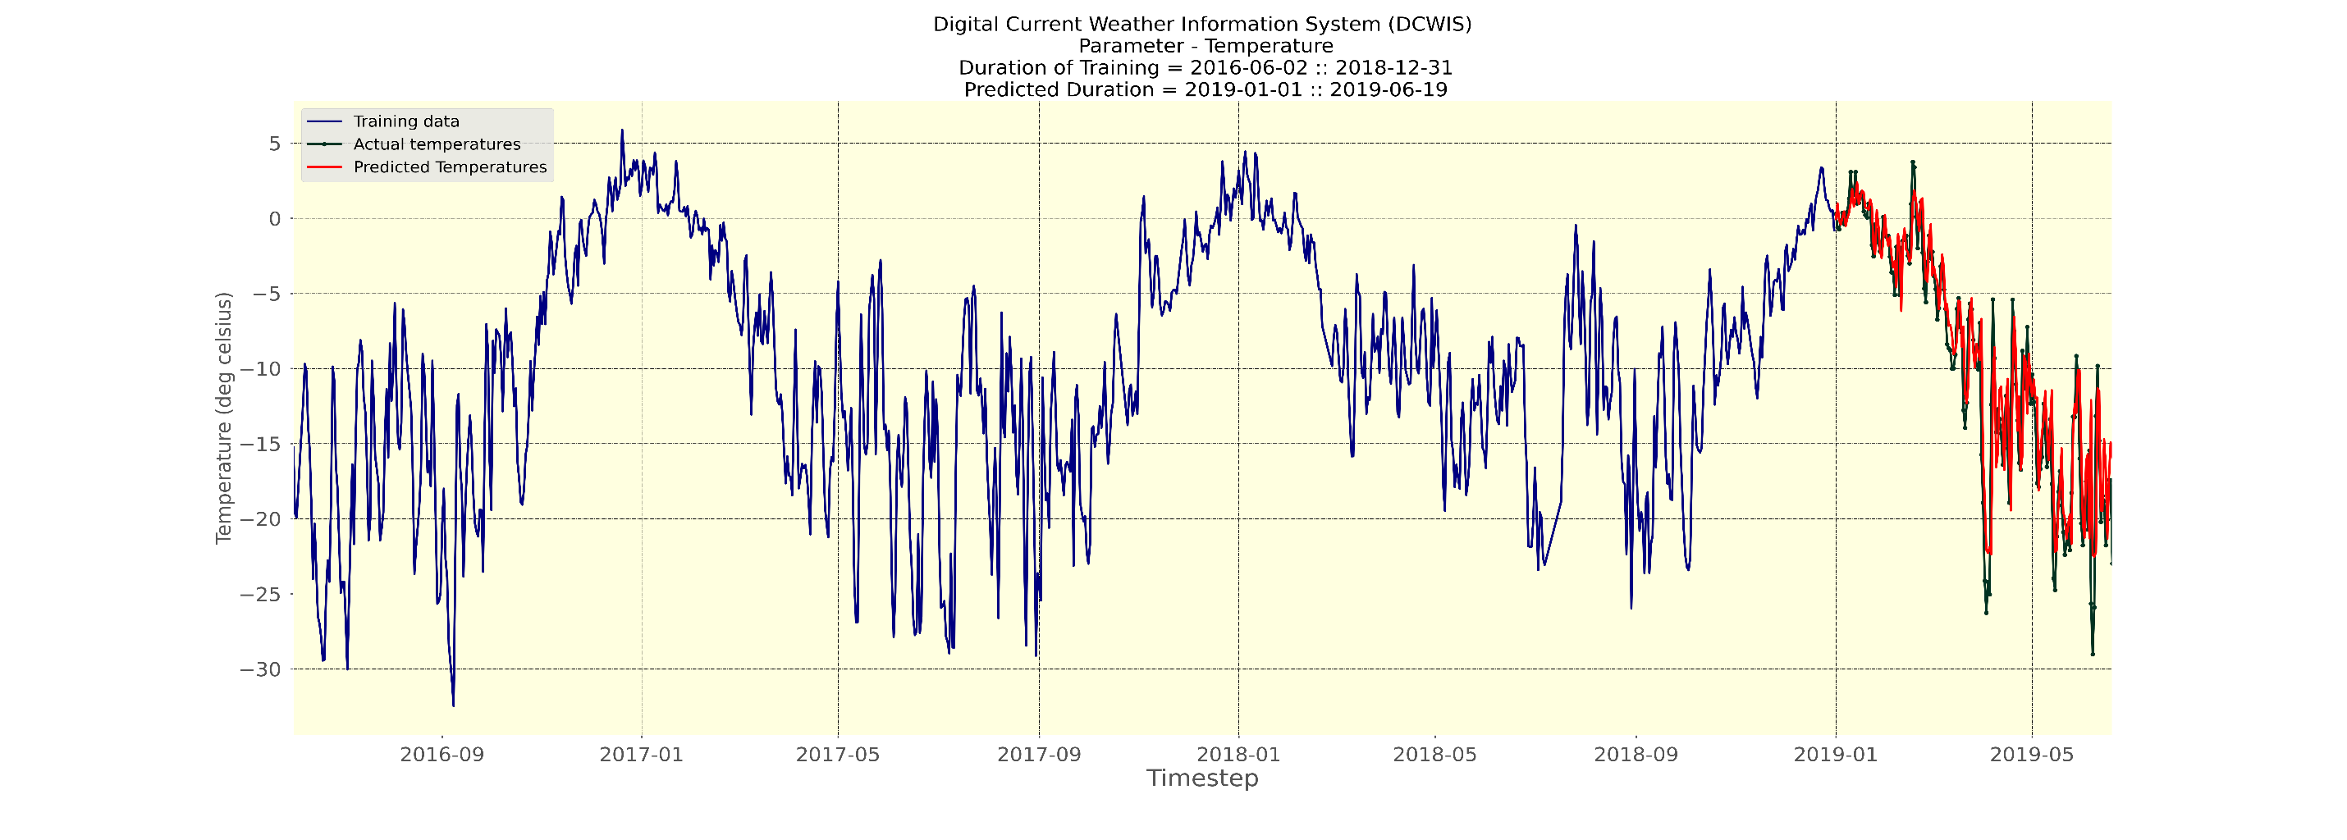
MODEL USED – RNN (GRU)
MAE (Mean Absolute Error) | MSE (Mean Squared Error) | RMSE (Root Mean Squared Error)
2.13 | 9.21 | 3.03

Slide 14
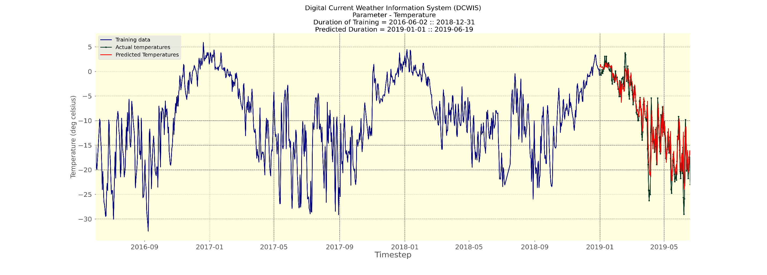
MODEL USED – LSTM
MAE (Mean Absolute Error) | MSE (Mean Squared Error) | RMSE (Root Mean Squared Error)
2.09 | 8.92 | 2.98

Slide 15
Performance metrics on test set (80-20 split) and analysis
 | MAE | MSE | RMSE
CNN | 2.58 | 12.12 | 3.48
RNN | 2.13 | 9.21 | 3.03
LSTM | 2.09 | 8.92 | 2.98
It is clear from the above metrics that LSTM performs best followed by GRU and CNN.
But why do LSTM and GRU perform considerably better than CNN ??

Slide 16
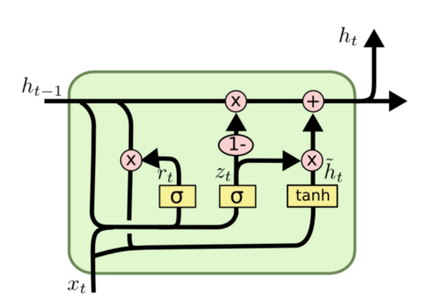
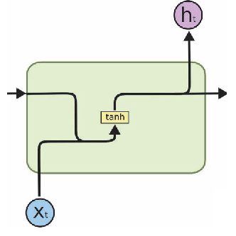
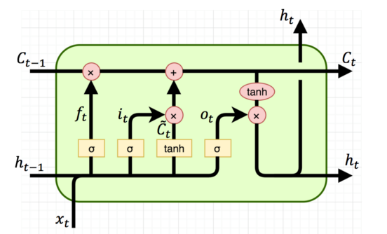

Slide 17
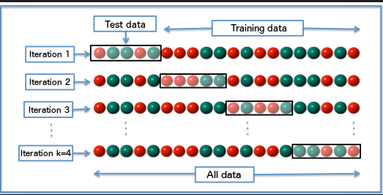
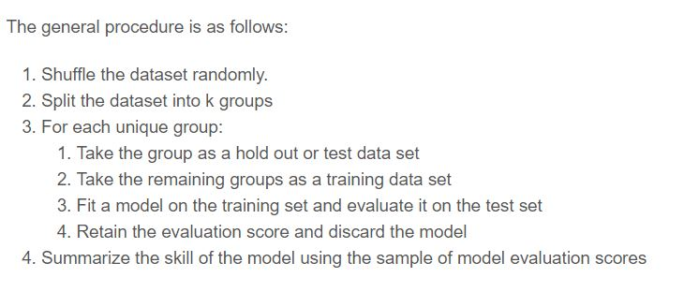
K-FOLD CROSS VALIDATION
Cross validation (CV) is one of the technique used to test the effectiveness of a machine learning models, it is also a re-sampling procedure used to evaluate a model if we have a limited data.
K-fold cross validation is a procedure used to estimate the skill of the model on new data. K-Fold is a popular and easy to understand, it generally results in a less biased model compare to other methods. Because it ensures that every observation from the original dataset has the chance of appearing in training and test set.

Slide 18
K-Fold Cross Validation for time series data
The problem with time series data is that adjacent data points are often highly dependent, so standard cross validation will fail (temporal dependence). Hence, traditional k-fold cross validation is too naïve and fundamentally wrong for time series data. Hence, we need a modified version to apply to time series.
The remedy is to apply an expanding window as shown in the adjacent diagram
The performance metrics on test set after applying k-fold cross validation ( I have used k = 6 ) is also shown.
 | MAE | MSE | RMSE
CNN | 2.61 | 12.1 | 3.4
RNN(GRU) | 2.25 | 9.56 | 3.03
LSTM | 2.24 | 9.4 | 3.00

Slide 19
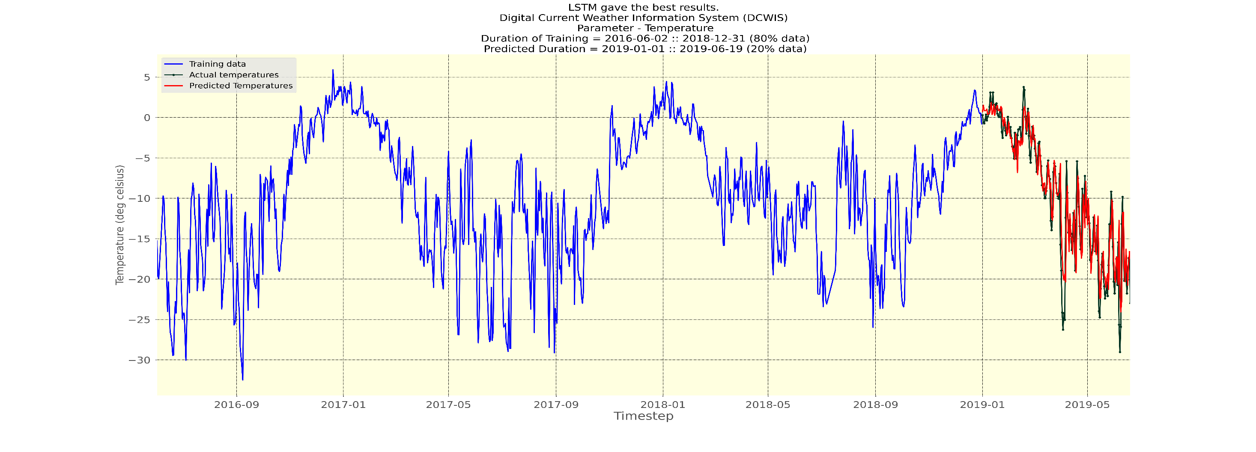
Predictive Modeling (Choosing the best model)
It is important that our project should give the best results choosing the best model automatically. This is called Predictive Modeling. This also makes our project robust.
We calculate the performance metrics on the test set using all the models and the model which gives lowest RMSE is chosen to finally output the predictions to the user.

Slide 20
CONCLUDING REMARKS
Weather forecasting is an interesting research problem with wide potential applications ranging from flight navigation to agriculture and tourism.
The challenges of weather forecasting, among others, are learning weather representation using a massive volume of weather dataset and building a robust weather prediction model which exploits hidden structural patterns in the massive volume weather dataset.
We visualised the our data and applied 3 DL models to forecast temperature.
K-fold allows us to get an idea about the overall performance of model.
Deep learning models such as merged LSTMs, CRNNs give the best results currently.
The current project also looks to exploit these models and achieve their results of temperature and precipitation forecasting.

Slide 21
REFERENCES
[1] https://towardsdatascience.com/how-to-use-convolutional-neural-networks-for-time-series-classification-56b1b0a07a57
[2] https://machinelearningmastery.com/how-to-develop-lstm-models-for-time-series-forecasting/
[3] https://towardsdatascience.com/why-and-how-to-cross-validate-a-model-d6424b45261f
[4] https://machinelearningmastery.com/k-fold-cross-validation/
[5] Afan Galih Salman, Bayu Kanigoro, Yaya Heryadi, Weather forecasting using deep learning techniques, 015 International Conference on Advanced Computer Science and Information Systems (ICACSIS), pages 281-285

